Slide 1

ST.JOSEPH
COLLEGE OF ENGINEERING
MULTILINGUAL
VIRTUAL ASSISTANT CLASSROOM
PRESENTED BY
TEAM LEADER :BALAJI B
TEAM MEMBER :MAHALAKSHMI V
GUIDED BY
Mr. S. KARTHI M.E
Assistant professor,
Dept of Information Technology

Slide 2
ABSTRACT
Our project aims to develop a comprehensive online platform facilitating efficient communication between students and staff within educational institutions.
The system features a secure login portal for both students and staff members, ensuring data privacy and access control. Upon logging in, students are directed to a user-friendly home page offering multilingual translation capabilities, enabling seamless communication regardless of language barriers.
Students can effortlessly submit assignments through the platform, which are then automatically summarized and organized for review by staff members.
This streamlines the assignment evaluation process, enhancing productivity and reducing administrative overhead. Moreover, students can submit queries through the system, and staff members can promptly respond, fostering effective communication and timely resolution of academic concerns.
By integrating language translation, assignment submission, summarization, and query resolution functionalities, our project aims to optimize the educational experience and promote collaboration within educational institutions.

Slide 3
INTRODUCTION
In today's globalized world, educational institutions face the challenge of fostering effective communication and collaboration among diverse student populations and faculty members.
Our project addresses this challenge by developing a comprehensive online platform tailored for educational environments. The system features a secure login portal that ensures privacy and access control for students and staff.
Upon logging in, students are provided with a user-friendly interface equipped with multilingual translation capabilities, facilitating seamless communication across language barriers.
This feature is especially crucial in multicultural learning environments where students may come from different linguistic backgrounds. Moreover, the platform enables students to submit assignments effortlessly, which are automatically summarized and organized for review by staff members.
By streamlining the assignment submission and evaluation process, the system enhances productivity and reduces administrative burden.
Additionally, students can submit queries through the platform, and staff members can promptly respond, fostering a supportive learning environment and ensuring timely resolution of academic concerns.
Through the integration of language translation, assignment submission, summarization, and query resolution functionalities, our project aims to optimize the educational experience and promote collaboration within educational institutions.

Slide 4
OBJECTIVE
The primary objective of our project is to develop an innovative online platform that facilitates seamless communication and collaboration within educational institutions.
Leveraging Natural Language Processing (NLP) techniques, particularly text summarization, our system aims to streamline the assignment submission process and enhance communication between students and staff members.
By automating the summarization of submitted assignments, the project seeks to improve efficiency in evaluating student work, reducing the time and effort required by faculty members.
Furthermore, the integration of multilingual translation capabilities addresses language barriers, promoting inclusivity and enabling effective communication among students from diverse linguistic backgrounds.
Another key objective is to establish a query resolution system that allows students to submit academic inquiries and receive timely responses from staff members.
Through these functionalities, the project aims to optimize the educational experience, foster collaboration, and support the academic success of students within educational institutions.

Slide 5
SCOPE OF PROJECT
The automatic summarization feature enhances the accessibility and usability of submitted assignments, allowing staff members to quickly grasp key points and provide timely feedback.
Moreover, the multilingual translation capability addresses language barriers, enabling students from diverse linguistic backgrounds to communicate effectively with peers and faculty members.
This fosters inclusivity and diversity within the educational environment, promoting a more supportive and collaborative learning atmosphere.

Slide 6
MOTIVATION OF PROJECT
The motivation behind our project stems from the recognition of several challenges faced by educational institutions in fostering effective communication and collaboration.
One of the primary motivations is the increasingly diverse student population within educational settings, where students often come from different cultural and linguistic backgrounds.
This diversity poses challenges in communication, particularly when students encounter language barriers in interacting with their peers and faculty members. Additionally, the manual process of assignment submission and evaluation can be time-consuming and prone to errors, leading to inefficiencies in academic workflows.
Furthermore, the lack of a centralized system for addressing student queries may result in delays in obtaining academic support and clarification.
By addressing these challenges, our project aims to improve the overall efficiency, inclusivity, and effectiveness of communication within educational institutions.
Through the integration of multilingual translation, automated text summarization, and query resolution functionalities, the project seeks to enhance the learning experience for students and streamline administrative processes for faculty members.

Slide 7
PROBLEM STATEMENT
Educational institutions face several challenges in facilitating efficient communication and collaboration among students and faculty members.
One of the primary issues is the diverse linguistic backgrounds of students, which often leads to language barriers hindering effective communication.
This poses a significant challenge in ensuring that all students can participate fully in academic discussions and activities.
Additionally, the manual process of assignment submission and evaluation is time-consuming and error-prone, resulting in delays in providing feedback to students.
Moreover, the lack of a centralized system for addressing student queries leads to inefficiencies in obtaining academic support and clarification.
These challenges not only impact the overall efficiency of academic workflows but also hinder the inclusivity and accessibility of educational environments.

Slide 8
LITERATURE SURVEY
REFERENCE PAPER-1
TITLE: A Comprehensive Review of Arabic Text Summarization
AUTHOR: ASMAA ELSAID, AMMAR MOHAMMED , LAMIAA FATTOUH IBRAHIM , MOHAMMED M. SAKRE
YEAR: 2022
ABSTRACT:The explosion of online and offline data has changed how we gather, evaluate, and understand data. It is frequently difficult and time-consuming to comprehend large text documents and extract crucial information from them. Text summarization techniques address the mentioned problems by compressing long texts while retaining their essential contents. These techniques rely on the fast delivery of filtered, high-quality content to their users. Due to the massive amounts of data generated by technology and various sources, automated text summarization of large-scale data is challenging. There are three types of automatic text summarization techniques: extractive, abstractive, and hybrid. Regardless of these previous techniques, the generated summaries are a long way from the summarization produced by human experts. Although Arabic is a widely spoken language that is frequently used for content sharing on the web, Arabic text summarization of Arabic content is limited and still immature because of several problems, including the Arabic language’s morphological structure, the variety of dialects, and the lack of adequate data sources. This paper reviews text summarization approaches and recent deep learning models for this approach. Additionally, it focuses on existing datasets for these approaches, which are also reviewed, along with their characteristics and limitations. The most often used metrics for summarization quality evaluation are ROUGE1, ROUGE2, ROUGE L, and Bleu. The challenges that are encountered during Arabic text summarizing methods and approaches and the solutions proposed in each approach are analyzed. Many Arabic text summarization methods have problems, such as the lack of golden tokens during testing, being out of vocabulary (OOV) words, repeating summary sentences, lack of standard systematic methodologies and architectures, and the complexity of the Arabic language. Finally, providing the required corpora, improving evaluation using semantic representations, the lack of using rouge metrics in abstractive text summarization, and using recent deep learning models to adopt them in Arabic summarization studies is an essential demand.

Slide 9
LITERATURE SURVEY
PAPER:2
TITLE: A Review on Optimization-Based Automatic Text Summarization Approach
AUTHOR: MUHAMMAD HAFIZUL H. WAHAB 1 , NOR HAFIZA ALI 2 , NOR ASILAH WATI ABDUL HAMID 1,2, (Senior Member, IEEE), SHAMALA K. SUBRAMANIAM1 , (Member, IEEE), ROHAYA LATIP 1 , (Member, IEEE), AND MOHAMED OTHMAN 1,2, (Senior Member, IEEE)
YEAR: 2023
ABSTRACT: The significance of automatic text summarization (ATS) lies in its task of distilling textual information into a condensed yet meaningful structure that preserves the core message of the original content. This summary generated by ATS plays a crucial role in simplifying the processing of textual information, as it captures the primary ideas of the source text while eliminating lengthy and irrelevant textual components. At present, the landscape of ATS is enriched with a multitude of innovative approaches, with a notable focus on optimization-based methods. These optimization-driven ATS techniques have introduced new perspectives, illuminating the field with their heightened accuracy in terms of metrics like ROUGE scores. Through this exploration, the paper underscores the gains and trade-offs associated with adopting optimization-based ATS compared to other strategies, specifically with the application of real-time ATS.

Slide 10
LITERATURE SURVEY
PAPER:3
TITLE: Feature Based Automatic Text Summarization Methods: A Comprehensive State-of-the-Art Survey
AUTHOR: DIVAKAR YADAV 1 , (Senior Member, IEEE), RISHABH KATNA2 , ARUN KUMAR YADAV1 , AND JORGE MORATO 3
YEAR: 2022
ABSTRACT: With the advent of the World Wide Web, there are numerous online platforms that generate huge amounts of textual material, including social networks, online blogs, magazines, etc. This textual content contains useful information that can be used to advance humanity. Text summarization has been a significant area of research in natural language processing (NLP). With the expansion of the internet, the amount of data in the world has exploded. Large volumes of data make locating the required and best information time-consuming. It is impractical to manually summarize petabytes of data; hence, computerized text summarization is rising in popularity. This study presents a comprehensive overview of the current status of text summarizing approaches, techniques, standard datasets, assessment criteria, and future research directions. The summarizing approaches are assessed based on several characteristics, including approachbased, document-number-based, Summarization domain-based, document-language-based, output summary nature, etc..

Slide 11
LITERATURE SURVEY
PAPER: 4
TITLE: Tulu Language Text Recognition and Translation
AUTHOR: PRATHWINI1 , ANISHA P. RODRIGUES 2 , P. VIJAYA 3 , AND ROSHAN FERNANDES 2
YEAR: 2024
ABSTRACT: Language is a primary means of communication, but it is not the only means; knowing a language does, however, assist speed up the process. Many distinct languages are spoken worldwide, and people use them to communicate. This is only one of the many reasons why language is so crucial. During the evaluation the system was tested on a dataset consisting of handwritten characters during the evaluation process Convolutional Neural Networks used achieved an accuracy rate of 92%. To translate English to the Tulu language, we employed a parallel sentence dataset for the neural approach and a parallel word dataset for the rule-based approach. The rule-based approach resulted in an 89% accuracy rate for word-based analysis and an 81% accuracy rate for sentence-based analysis for the English-to-Tulu language translation. The neural machine translation approach of the Encoder-Decoder model with LSTM is been used to accomplish translation from English to Tulu with a BLEU score of 0.83 and Tulu to English with a BLUE score of 0.65. The model also employed hybrid machine translation to enhance the translation.

Slide 12
LITERATURE SURVEY
PAPER: 5
TITLE: The Impact of Artificial Intelligence on Language Translation: A Review
AUTHOR: YASIR ABDELGADIR MOHAMED 1 , (Member, IEEE), AKBAR KHANAN1 , MOHAMED BASHIR1 , ABDUL HAKIM H. M. MOHAMED 1 , (Senior Member, IEEE), MOUSAB A. E. ADIEL 2 , AND MUAWIA A. ELSADIG 3
YEAR: 2021
ABSTRACT: In the context of a more linked and globalized society, the significance of proficient cross-cultural communication has been increasing to a position of utmost importance. Language functions as a crucial medium that establishes connections among people, corporations, and countries, demanding the implementation of precise and effective translation systems. This comprehensive review paper aims to contribute to the evolving landscape of AI-driven language translation by critically examining the existing literature, identifying key debates, and uncovering areas of innovation and limitations. The primary objective is to provide a nuanced understanding of the current state of AI-driven language translation, emphasizing the advancements, challenges, and ethical considerations. In this review, The future trajectory of this study involves the incorporation of cross-lingual dialect adaptability and the advancement of Artificial Intelligence translation systems, with a focus on prioritizing inclusion and cultural understanding.

Slide 13
EXISTING SYSTEM
In the existing educational framework, assignment submission and query resolution processes often rely on manual methods, leading to inefficiencies and communication barriers.
Students typically submit assignments through conventional means such as email or physical submission, which can be time-consuming for both students and faculty members to manage.
Furthermore, the lack of standardized platforms for query resolution results in disparate communication channels, making it challenging for students to obtain timely academic support and clarification.
Additionally, existing systems may not address the linguistic diversity within educational institutions, thereby limiting effective communication among students and faculty members from different language backgrounds.
Overall, the current system lacks a centralized, automated solution that streamlines assignment submission, facilitates multilingual communication, and provides efficient query resolution mechanisms.

Slide 14

DISADVANTAGES
Manual methods for assignment submission and query resolution, leading to inefficiencies and increased workload for both students and faculty members.
The absence of multilingual support in the existing system creates communication barriers for students and faculty members from diverse linguistic backgrounds, hindering effective collaboration and understanding.

Slide 15
PROPOSED SYSTEM
Our proposed system aims to revolutionize the assignment submission and query resolution processes within educational institutions by introducing a comprehensive and technologically advanced platform.
The proposed system will automate and streamline assignment submission through a user-friendly online portal, reducing the administrative burden on both students and faculty members.
Leveraging Natural Language Processing (NLP) techniques, the system will offer multilingual support, allowing students and faculty members to communicate effectively regardless of their linguistic backgrounds.
Additionally, the system will incorporate automated text summarization algorithms to expedite the evaluation process, enabling faculty members to provide timely feedback on submitted assignments
Furthermore, the proposed system will feature a centralized query resolution mechanism, allowing students to submit academic inquiries through the platform and receive prompt responses from faculty members.
By integrating these functionalities into a single platform, our proposed system aims to enhance communication, collaboration, and efficiency within educational institutions, ultimately improving the overall learning experience for students and optimizing administrative processes for faculty members.

Slide 16

ADVANTAGES
Leveraging Natural Language Processing (NLP) techniques, the system offers text summarization capabilities, enabling faster evaluation of assignments and timely provision of feedback to students.
With automated text summarization and streamlined communication channels, faculty members can provide timely feedback on submitted assignments, enhancing the learning experience for students.

Slide 17

SYSTEM CONFIGURATION
H/W SYSTEM CONFIGURATION:
Processor - I5/ I7/ Amd Processor
Ram - Above 8 Gb
Hard Disk - Above 500 Gb
S/W SYSTEM CONFIGURATION:
Operating system - windows 8/10
Front end - html , css
Script - python language
Tool - python idle

Slide 18
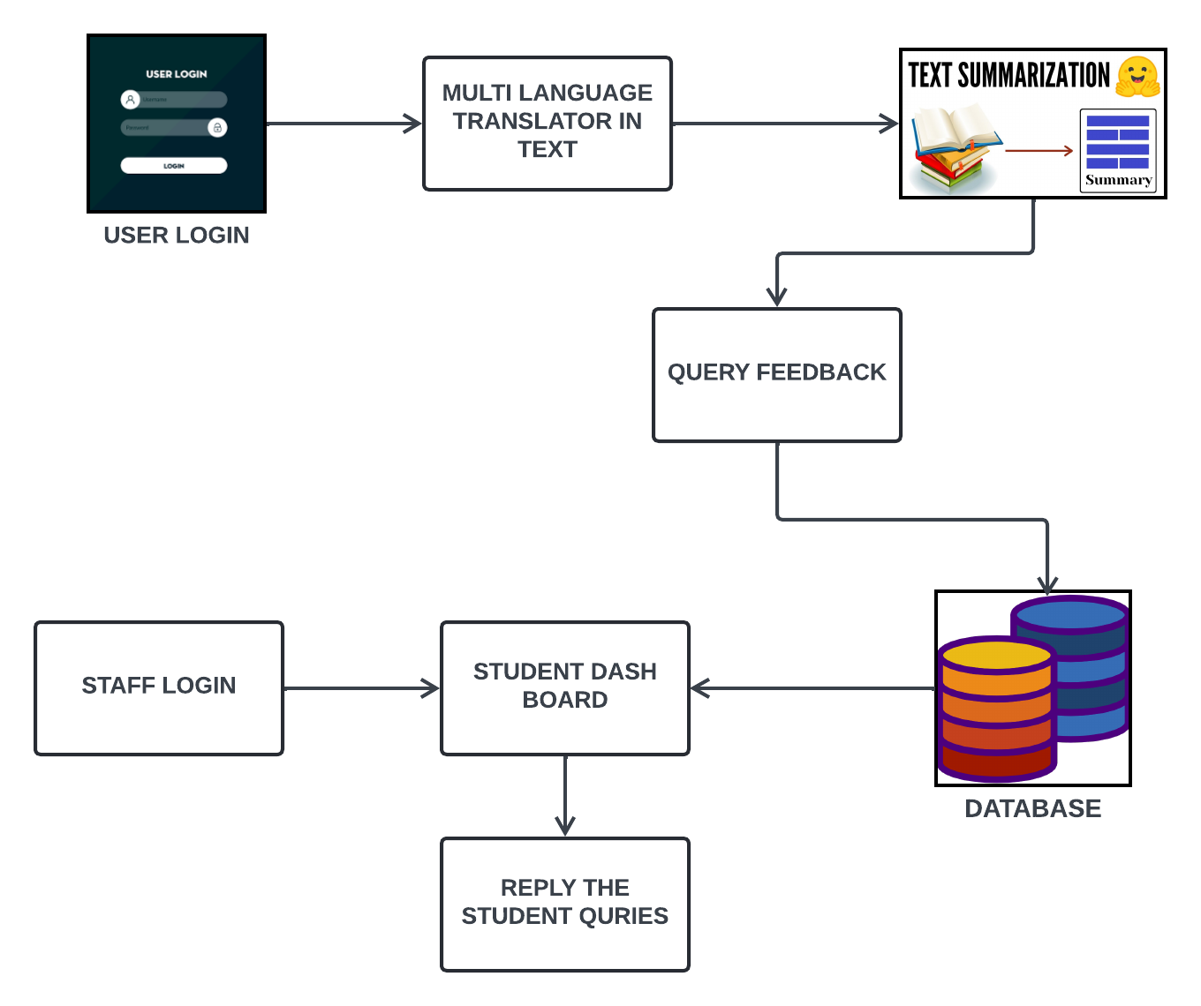
ARCHITECTURE DIAGRAM

Slide 19

MODULES NAME
LANGUAGE TRANSLATION
NLP IN TEXT SUMMARIZATION
TOKENIZATION AND STOPWORDS
STAFF MODULE

Slide 20
MODULES DESCRIPTION
LANGUAGE TRANSLATION:
The Multi-Language Translation Module is an integral component of our system, designed to facilitate seamless communication among users from diverse linguistic backgrounds within educational institutions. Leveraging the power of the Google Translator API, this module enables automatic translation of text inputs from one language to another, ensuring that users can interact and collaborate effectively in their preferred language. When a user submits text, such as a query or assignment, the module detects the language of the input text and translates it into the desired language selected by the recipient. This translated text is then seamlessly displayed to the user, eliminating language barriers and promoting inclusivity within the educational environment. By providing this capability, the Multi-Language Translation Module enhances accessibility and fosters a supportive learning atmosphere where all users can engage meaningfully, regardless of their language proficiency.

Slide 21
MODULES DESCRIPTION
NLP IN TEXT SUMMARIZATION:
Natural language processing (NLP) is about developing applications and services that are able to understand human languages.
Some Practical examples of NLP are speech recognition for, eg: Google voice search, understanding what the content is about or sentiment analysis etc in our project we use the NLTK, NLTKstands for Natural Language Toolkit.
This toolkit is one of the most powerful NLP libraries which contain packages to make machines understand human language and reply to it with an appropriate response. Tokenization, Stopwords are some of these packages which will be discussed in this tutorial.

Slide 22
MODULES DESCRIPTION
TOKENIZATION AND STOPWORDS:
Tokenization is one of the first step in any NLP pipeline. Tokenization is nothing but splitting the raw text into small chunks of words or sentences, called tokens.
If the text is split into words, then its called as 'Word Tokenization' and if it's split into sentences then its called as 'Sentence Tokenization'. Stop words are words that are so common they are basically ignored by typical tokenizes. By default, NLTK (Natural Language Toolkit) includes a list of 40 stop words, including: “a”, “an”, “the”, “of”, “in”, etc.
The stopwords in nltk are the most common words in data. stop words occur in abundance, hence providing little to no unique information that can be used for classification or clustering, by using Natural Language processing the summarized text will be generated.

Slide 23
MODULES DESCRIPTION
STAFF MODULE:
The staff-side interface of our system encompasses various modules tailored to streamline administrative tasks, facilitate efficient communication, and enhance the overall management of academic activities. One crucial module is the Assignment Summarization and Review Module, which automates the process of evaluating student assignments.
Leveraging Natural Language Processing (NLP) techniques, this module generates concise summaries of submitted assignments, allowing staff members to quickly grasp the key points and provide timely feedback to students.
Additionally, the Query Management Module enables staff members to efficiently address student inquiries and academic concerns. Through this module, staff members can view, organize, and respond to queries submitted by students, ensuring prompt resolution and effective communication.

Slide 24
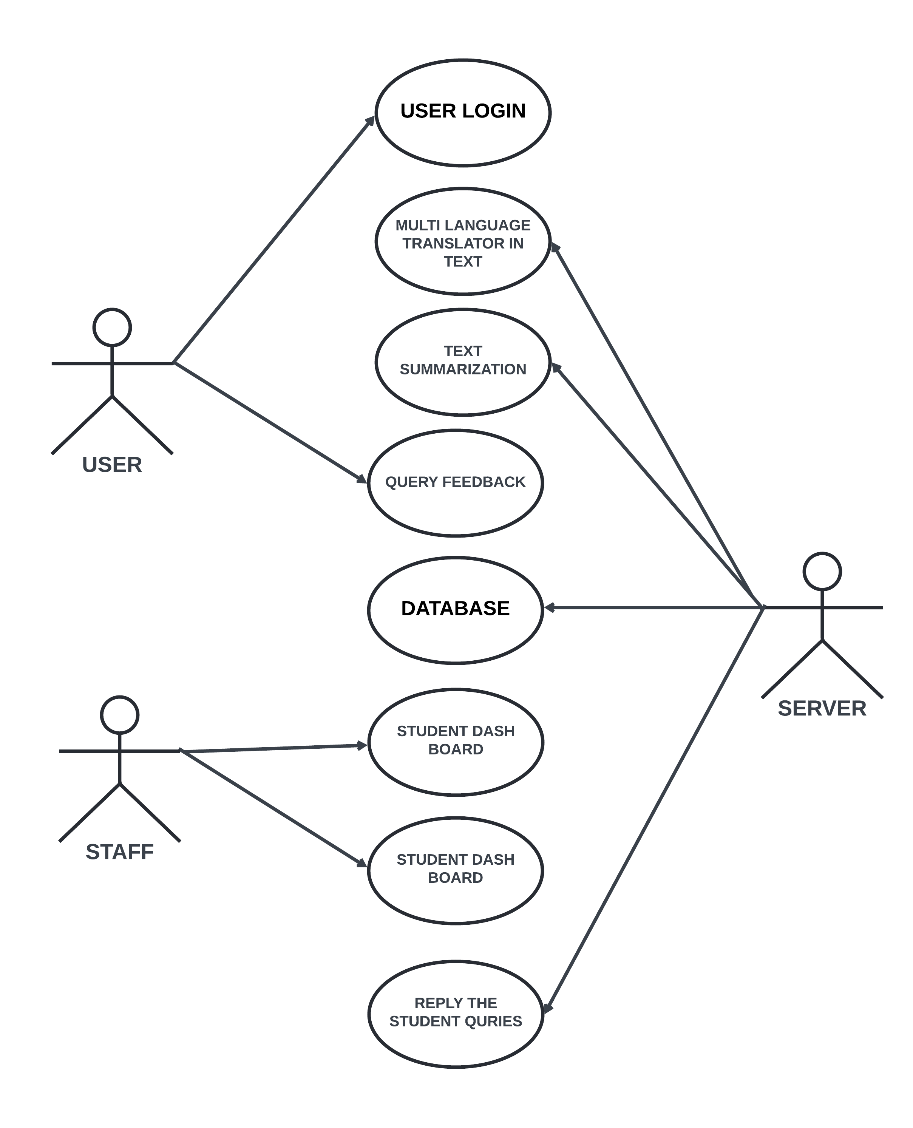
UML DIAGRAM
USE CASE DIAGRAM:

Slide 25
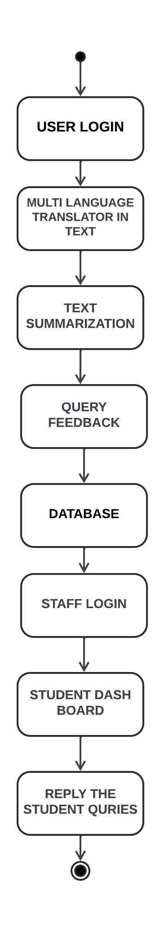
UML DIAGRAM
ACTIVITY DIAGRAM:

Slide 26
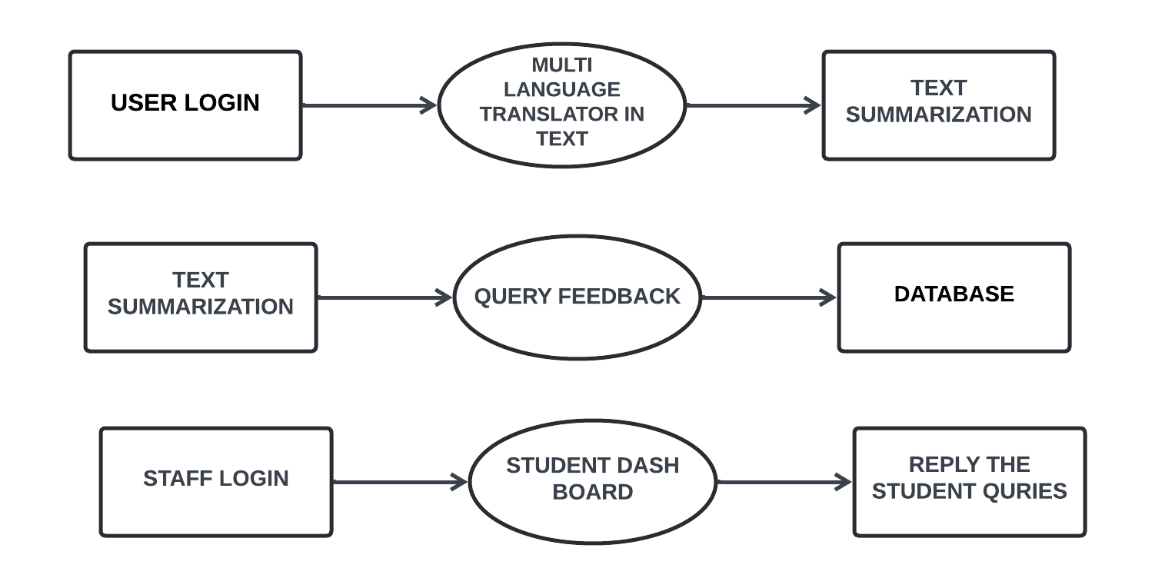
UML DIAGRAM
DATA FLOW DIAGRAM:
LEVEL 0:
LEVEL 1:
LEVEL 2:

Slide 27
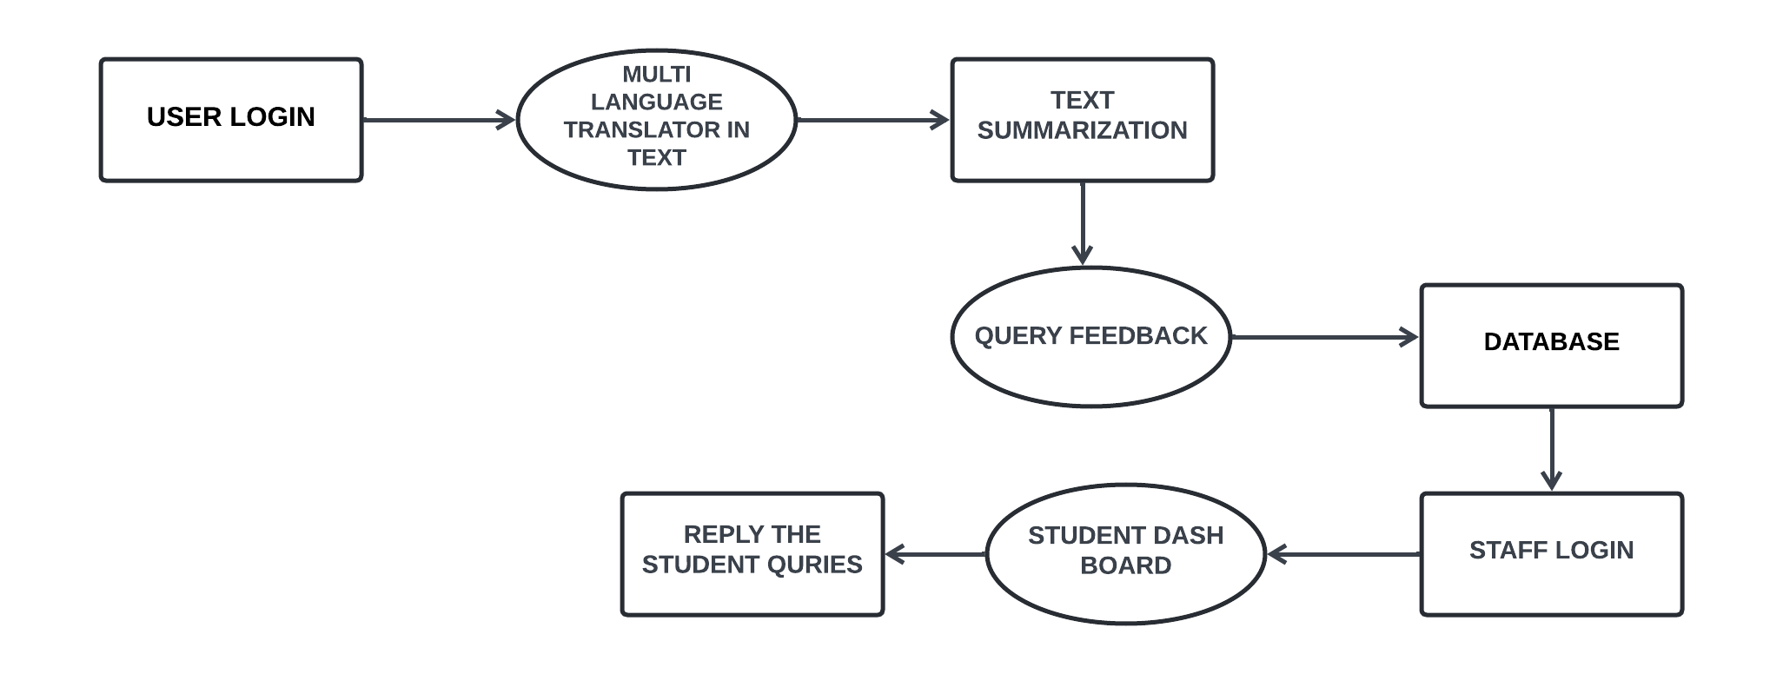
UML DIAGRAM
OVERALL DIAGRAM

Slide 28
PROPOSED SYSTEM TECHNIQUE
NLP (NATURAL LANGUAGE PROCESSING ):
Today, one of the most popular tasks in Data Science is processing information presented in the text form. Exactly this is text representation in the form of mathematical equations, formulas, paradigms, patterns in order to understand the text semantics (content) for its further processing: classification, fragmentation, etc. The general area which solves the described problems is called Natural Language Processing (NLP).
Among the tasks that Natural Language Processing solves the most important ones are:
text classification – definitions of text semantics for further processing (one of the most popular tasks to date);
named-entity recognition (NER) – definition and selection of entities with a predefined meaning (used to filter text information and understand general semantics);
summarization – the text generalization to a simplified version form (re-interpretation the content of the texts);
text generation – one of the tasks that are used to build AI-systems;
topic modeling – technique for extracting hidden topics from large text volumes.

Slide 29
PROPOSED SYSTEM TECHNIQUE
NLTK:
NLTK is a standard python library with prebuilt functions and utilities for the ease of use and implementation. It is one of the most used libraries for natural language processing and computational linguistics. Data pre-processing is the process of making the machine understand things better or making the input more machine understandable
Tokenization is the process of breaking text up into smaller chunks as per our requirements. nltk has a cool submodule “tokenize” which we will be using. Word Tokenization
Punctuations are of little use in NLP so they are removed.
Stop words are words which occur frequently in a corpus. e.g a, an, the, in. Frequently occurring words are removed from the corpus for the sake of text-normalization.
It is reduction of inflection from words. Words with same origin will get reduced to a form which may or may not be a word.

Slide 30
CONCLUSION
In conclusion, our project aims to revolutionize communication and administrative processes within educational institutions through the development of a comprehensive online platform.
By integrating features such as multilingual translation, automated assignment summarization, and efficient query resolution mechanisms, we have created a system that promotes inclusivity, streamlines workflow, and enhances the overall learning experience for students and staff members alike.
Through the implementation of cutting-edge technologies such as Natural Language Processing (NLP) and integration with the Google Translator API, we have successfully addressed the challenges of language barriers and manual administrative tasks. Our system empowers users to communicate seamlessly across linguistic boundaries, submit assignments with ease, and obtain timely academic support and feedback.
Furthermore, the centralized nature of the platform ensures consistency, accessibility, and efficiency in managing academic activities. Moving forward, we envision our project making a significant impact in educational environments, facilitating collaboration, fostering a supportive learning atmosphere, and ultimately contributing to the advancement of academic excellence within educational institutions.

Slide 31
FUTURE ENHANCEMENTS
For future enhancement, several avenues can be explored to further enrich the functionality and usability of our system. Firstly, the integration of advanced machine learning algorithms could enhance the accuracy and efficiency of the text summarization module, allowing for more nuanced and comprehensive summaries of submitted assignments.
Additionally, incorporating sentiment analysis capabilities could enable the system to gauge the sentiment of student queries and responses, thereby facilitating more personalized and empathetic interactions between students and staff members.
Furthermore, the development of a mobile application version of the platform could enhance accessibility and convenience for users, allowing them to access the system from their smartphones or tablets while on the go.
Moreover, the incorporation of advanced analytics and reporting features could provide deeper insights into user behavior, system usage patterns, and academic performance metrics, empowering educational institutions with valuable data-driven insights for decision-making and strategic planning.

Slide 32
REFERENCES
[1] A. Elsaid, A. Mohammed, L. F. Ibrahim and M. M. Sakre, "A Comprehensive Review of Arabic Text Summarization," in IEEE Access, vol. 10, pp. 38012-38030, 2022, doi: 10.1109/ACCESS.2022.3163292.
[2] M. H. H. Wahab, N. H. Ali, N. A. W. Abdul Hamid, S. K. Subramaniam, R. Latip and M. Othman, "A Review on Optimization-Based Automatic Text Summarization Approach," in IEEE Access, vol. 12, pp. 4892-4909, 2024, doi: 10.1109/ACCESS.2023.3348075.
[3] D. Yadav, R. Katna, A. K. Yadav and J. Morato, "Feature Based Automatic Text Summarization Methods: A Comprehensive State-of-the-Art Survey," in IEEE Access, vol. 10, pp. 133981-134003, 2022, doi: 10.1109/ACCESS.2022.3231016.
[4] Y. A. Mohamed, A. Khanan, M. Bashir, A. H. H. M. Mohamed, M. A. E. Adiel and M. A. Elsadig, "The Impact of Artificial Intelligence on Language Translation: A Review," in IEEE Access, vol. 12, pp. 25553-25579, 2024, doi: 10.1109/ACCESS.2024.3366802.
[5] Prathwini, A. P. Rodrigues, P. Vijaya and R. Fernandes, "Tulu Language Text Recognition and Translation," in IEEE Access, vol. 12, pp. 12734-12744, 2024, doi: 10.1109/ACCESS.2024.3355470.

Slide 33
REFERENCES
[6]J. M. Sanchez-Gomez, M. A. Vega-Rodríguez, and C. J. Pérez, ‘‘Extractive multi-document text summarization using a multi-objective artificial bee colony optimization approach,’’ Knowl.-Based Syst., vol. 159, pp. 1–8, Nov. 2018.
[7] I. Arroyo-Fernández, C.-F. Méndez-Cruz, G. Sierra, J.-M. TorresMoreno, and G. Sidorov, ‘‘Unsupervised sentence representations as word information series: Revisiting TF–IDF,’’ Comput. Speech Lang., vol. 56, pp. 107–129, Jul. 2019.
[8] M. K. Dahouda and I. Joe, ‘‘A deep-learned embedding technique for categorical features encoding,’’ IEEE Access, vol. 9, pp. 114381–114391, 2021.
[9] D. M. Blei, A. Y. Ng, and M. I. Jordan, ‘‘Latent Dirichlet allocation,’’ J. Mach. Learn. Res., vol. 3, pp. 993–1022, Mar. 2003.
[10] T. Mikolov, L. Sutskever, K. Chen, G. Corrado, and J. Dean, ‘‘Distributed representations of words and phrases and their compositionality,’’ in Proc. Adv. Neural Inf. Process. Syst., vol. 2, Dec. 2013, pp. 3111–3119.

Slide 34

THANK YOU

